Slide 1
Management Science Theory
Presented by : Reyoz Kumar Rayamajhi

Slide 2
Management Science Theory(Military Science)
It is also known as the mathematical or quantitative approach.
The approach makes use of the mathematical and quantitative models to solve complex business problems.
The developments taking place in computer and information technology have extended the application of management science approach to many other areas of business.
Management Science vs. Quantitative Management:
  Management Science focuses specifically on the development of mathematical models.
  Quantitative Management applies quantitative techniques to management.

Slide 3
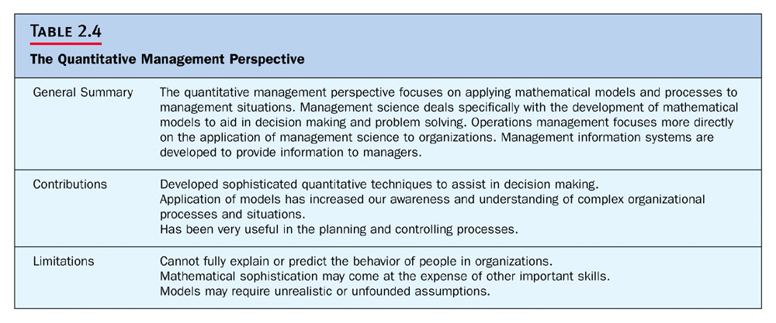
Continue…

Slide 4
The main branches of management science:
Quantitative management, which utilizes mathematical techniques, such as linear programming, modeling, queuing theory etc. to help managers make right decisions.
Operation management, which provides managers with a set of techniques that they can use to utilize an organization’s production system to increase efficiency.
Management Information system, which helps managers design information systems that provide information about events occurring within and outside an organization.

